Slide 1
1994

Slide 2
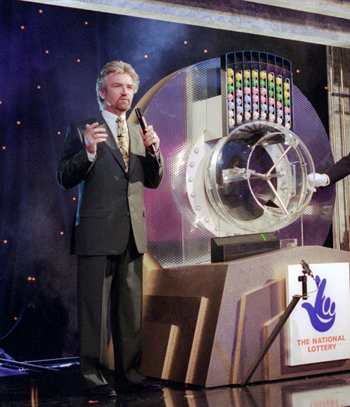
1994

Slide 3
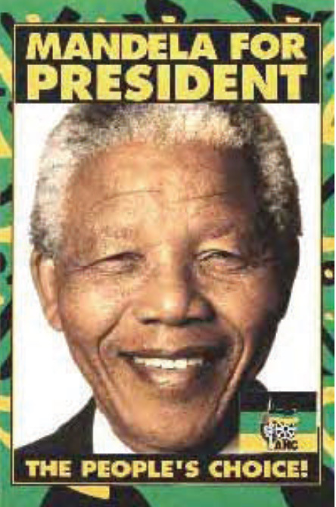
1994

Slide 4
1994
Channel Tunnel opened

Slide 5
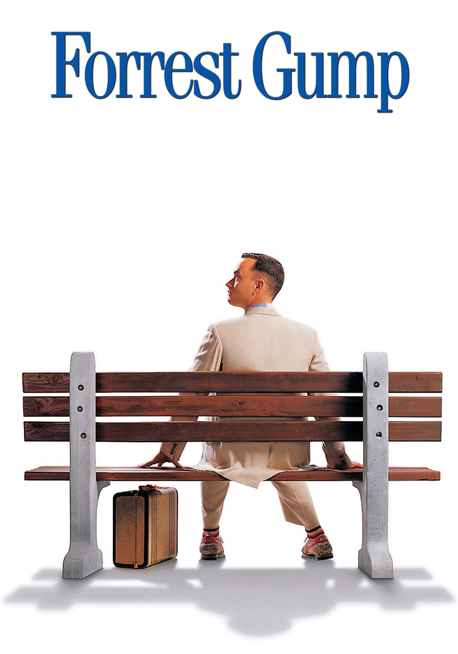
1994
Channel Tunnel opened

Slide 6
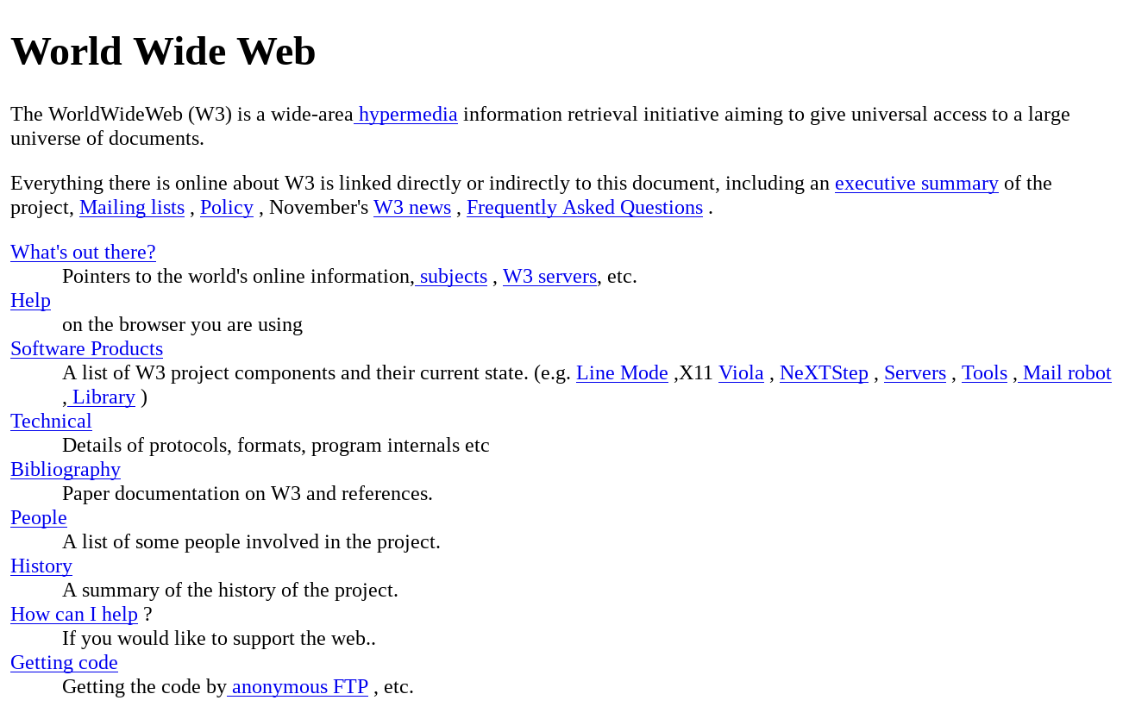
1994
The World Wide Web was born: Tim Berners-Lee first web page
Channel Tunnel opened

Slide 7


Slide 8
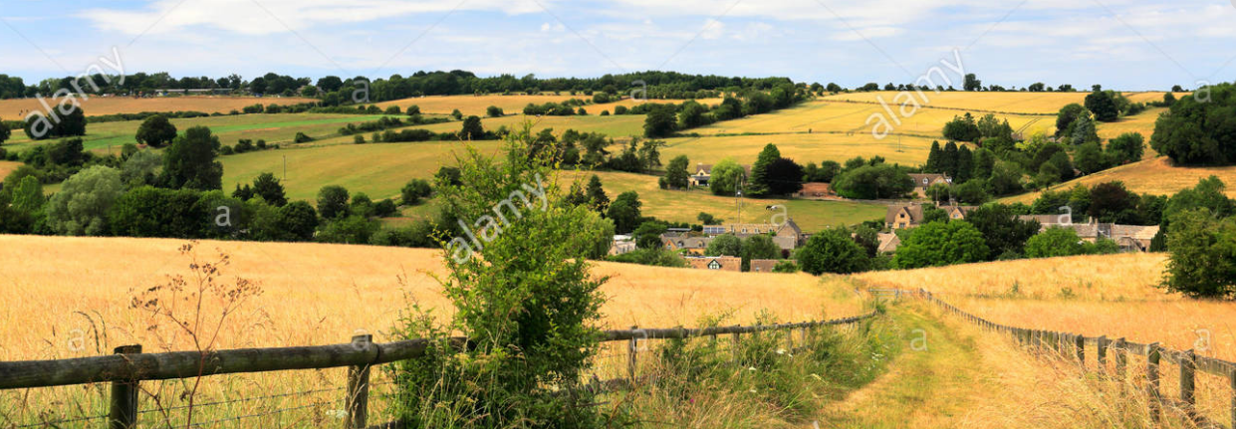
Battle of Windrush Valley

Slide 9
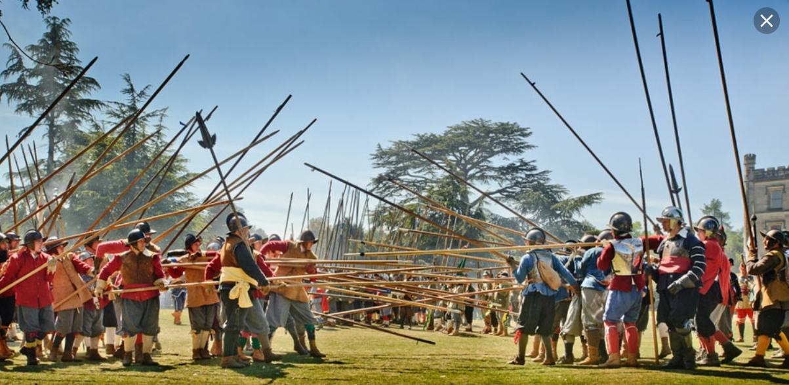

Slide 10
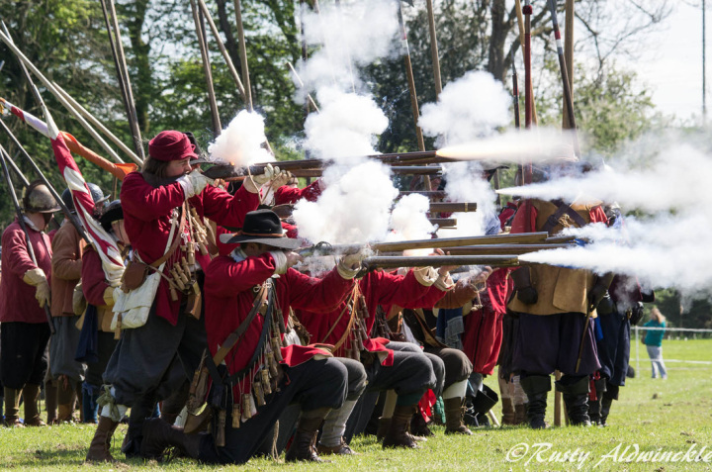
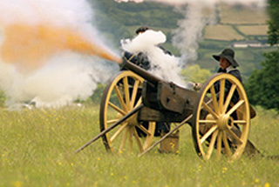
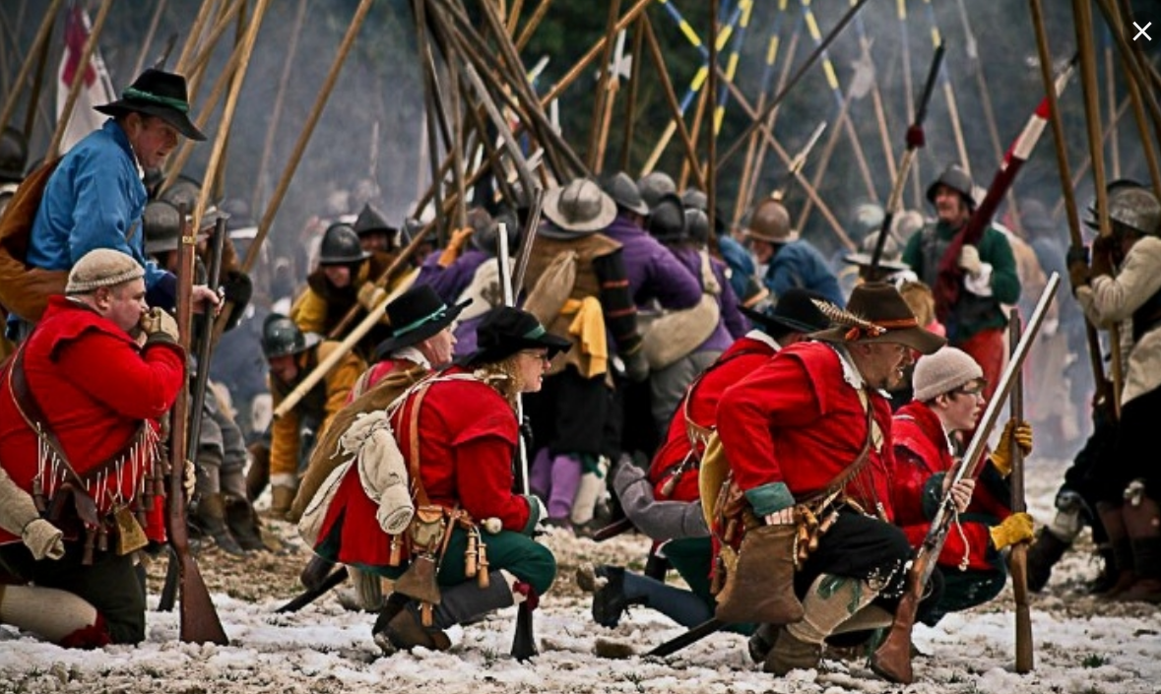
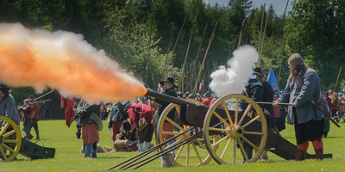

Slide 11


Slide 12
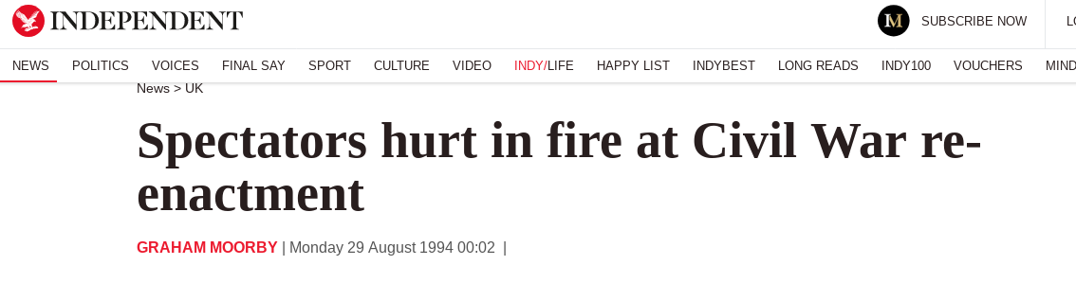
AT LEAST 20 people were hurt and up to 50 cars burnt out yesterday when fire engulfed a car park while thousands of Bank Holiday spectators watched a re-enactment of a Civil War battle.
Crowds fled in panic as flames fanned by strong winds moved towards them during the display by the Sealed Knot Society, named after the Royalist secret society, at Witney in Oxfordshire.
Fifty firemen fought the blaze and society members in costume abandoned the reconstruction to help keep the crowds away. Firemen took 30 minutes to extinguish the flames and motoring organisations towed gutted vehicles from the scene and helped to get others started.

